Slide 1
Introducing you to RAPID CARS Easy Book and Comfortable Ride
Made By:
Sayanish Chakraborty
Divyesh Patel
Bharg Trivedi

Slide 2
Trigger
There are millions of people travelling across thousands of places in a single hour of a day for different purposes over long distances.
And in present system all booking works are done manually and it is very difficult to maintain the information of booking and also it makes difficult to find vehicle available for booking.
Our RAPID CARS :-
provides a complete solution to all your day-to-day car booking office running needs.
Can book cars instantly and with great ease from your nearest location.
The User-Friendly environment and potential of running on any device, helps customer to choose their quality drive to their desire Destinations.

Slide 3
Tools/Technologies Used:
Technologies:
React
Node.js
MongoDB
Bootstrap
HTML
CSS
Tools:
Visual Studio Code
Post man
Git and GitHub
Platform:
Local development server

Slide 4
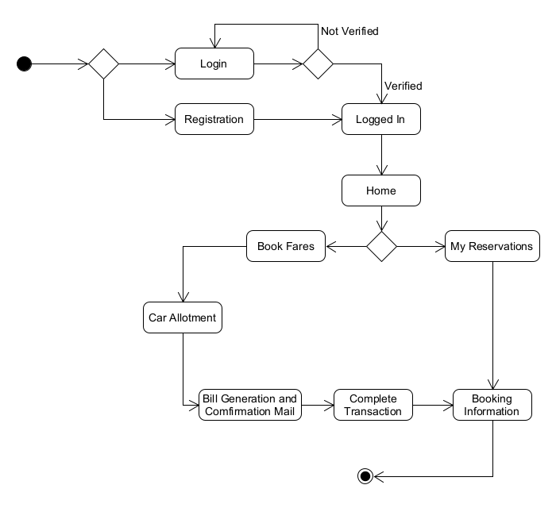
Flowchart

Slide 5
Main Functions for User
Sign up
Parameters: user email, username, mobile no, password.
Description: User data save in the User Database.
Login
Parameters: user email, password
Description: User authenticated then logged in.
Sort and Filter Car
Parameters: car data
Description: Cars are shown on the booking page according to user-selected choice.

Slide 6
Main Functions for User
Boking
Parameters: location, date-time, user id, car id
Description: User booked car will be shown on my booking page with other details.
Cancel booking
Parameters: carid, booking id
Description: User can cancel the booking.
Confirmation Email
Parameters: user email, car details, booking details
Description: When user booked car email will be send and when new user has register.

Slide 7
Main Functions for Admin
Booking Completion
Parameters: user id, car id, booking id
Description: User is authenticated and then logged in.
Add Car
Parameters: car data
Description: Car Details gets added to the Car Database.

Slide 8
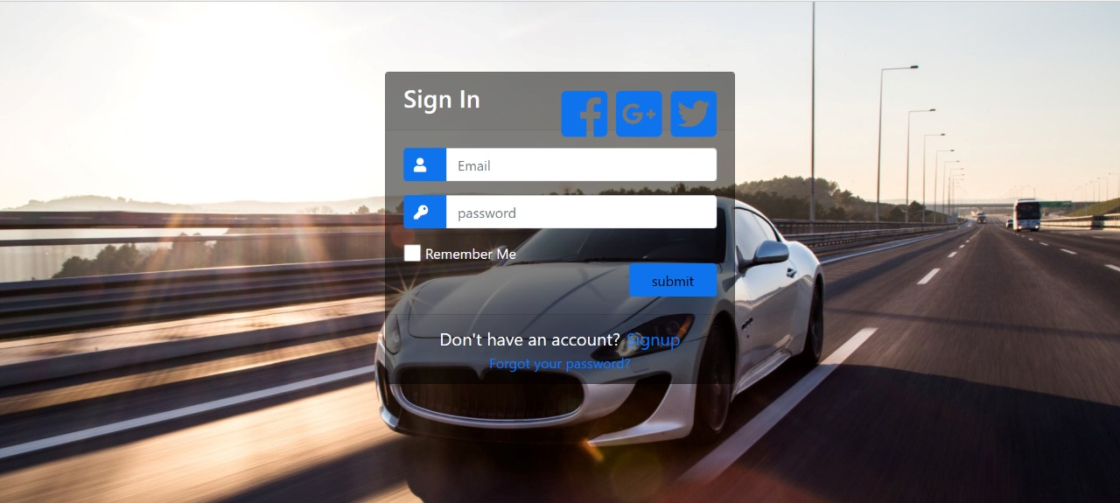
Design View of Website

Slide 9
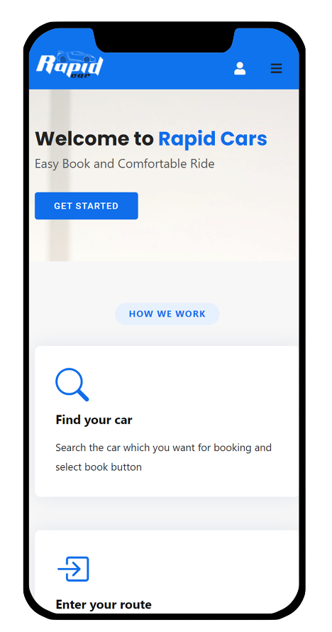
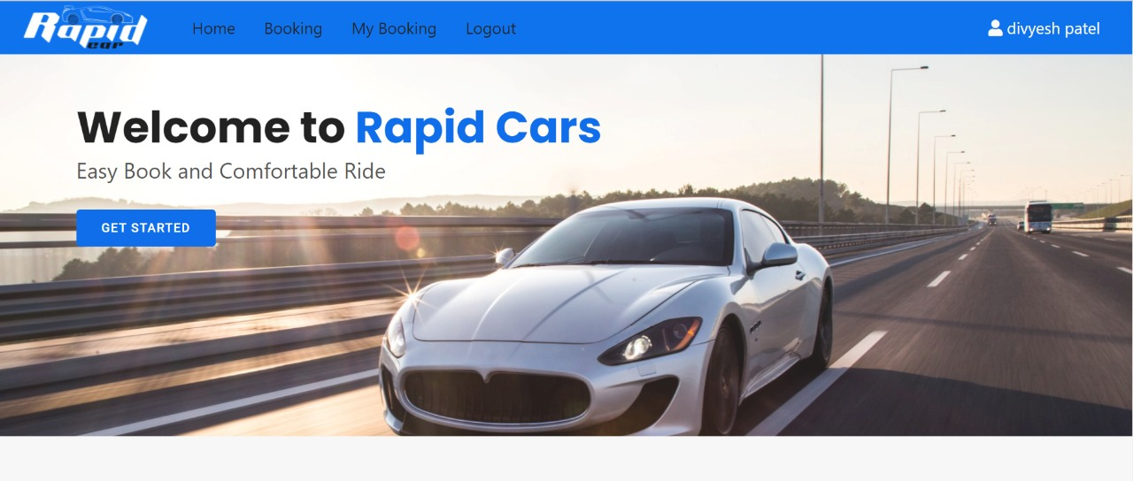
Design View of Website

Slide 10
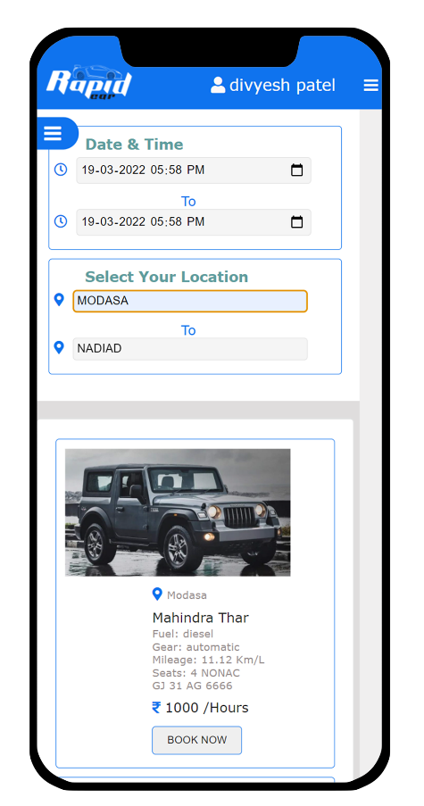
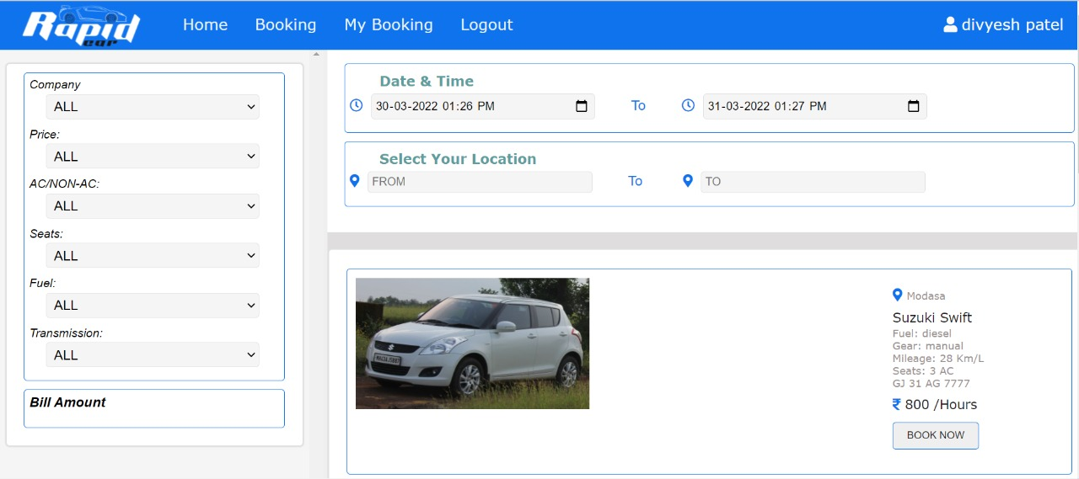
Design View of Website

Slide 11
Benefits
Automatic Fare Calculation
Based on the date, time, and vehicle type, the online car rental software program automatically calculates and provides the fare to customers.
Easy and Instant Booking System
Given that most people book online, it is true that mobile technology enhances the booking and software experience for customers. As a result of implementing a car rental booking system, your potential customers will be able to book a car from any location and at any time.
Round the Clock Availability
One of the greatest benefits of this system is its availability 24 hours a day, 7 days a week.

Slide 12
Benefits
Knowing Fleet Status
Helps car rental companies get fleet information such as bookings, agreements, and amazingly more.
Manages Bookings and Pricing
Vehicle Management
A complete Car Rental Software package includes detailed listing of car information, their management, travel history information, and other features.

Slide 13
Way Ahead…
The project can be extended with the support of Feedback System for more interactions and to provide more information, about their experiences on their trip with us, to customers.
Further extensions involve integrating it with Web API and integrating Machine Learning recommendation models for suggesting best cars on the basis of customer feedbacks for review.

Slide 14
Reference / Bibliography
Following links and websites were referred during the development of this project:
“JavaScript Tutorial.” W3Schools Online Web Tutorials, 16 Jan 2022
https://www.w3schools.com/js/.
Programming. React JS - React Tutorial for Beginners. YouTube, 29 Jan 2022
https://www.youtube.com/watch?v=Ke90Tje7VS0.
“What Is MongoDB Atlas? — MongoDB Atlas, 14 Feb 2022
https://docs.atlas.mongodb.com/.
“Self Drive Car Rentals | Rent a Car | Car Hire @ Zoomcar.” Zoomcar - India, 20 Jan 2022
https://www.zoomcar.com/.

Slide 15


